Slide 1

Coin Game for Arduino By Daniel Zhu
ELECTRICAL AND COMPUTER ENGINEERING, COLLEGE OF ENGINEERING AND APPLIED SCIENCE

Slide 2
Goals
This module can be used by younger students to hone their counting skills in increments of one, five, ten and twenty-five.
It is also useful to teach them to work with money, specifically how to give an exact amount of change.

Slide 3

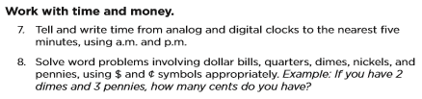
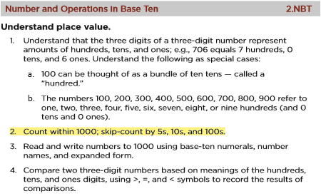
Applicable Education Standards
See Math Standards: https://edu.wyoming.gov/downloads/standards/final-2012-math-standards.pdf

Slide 4
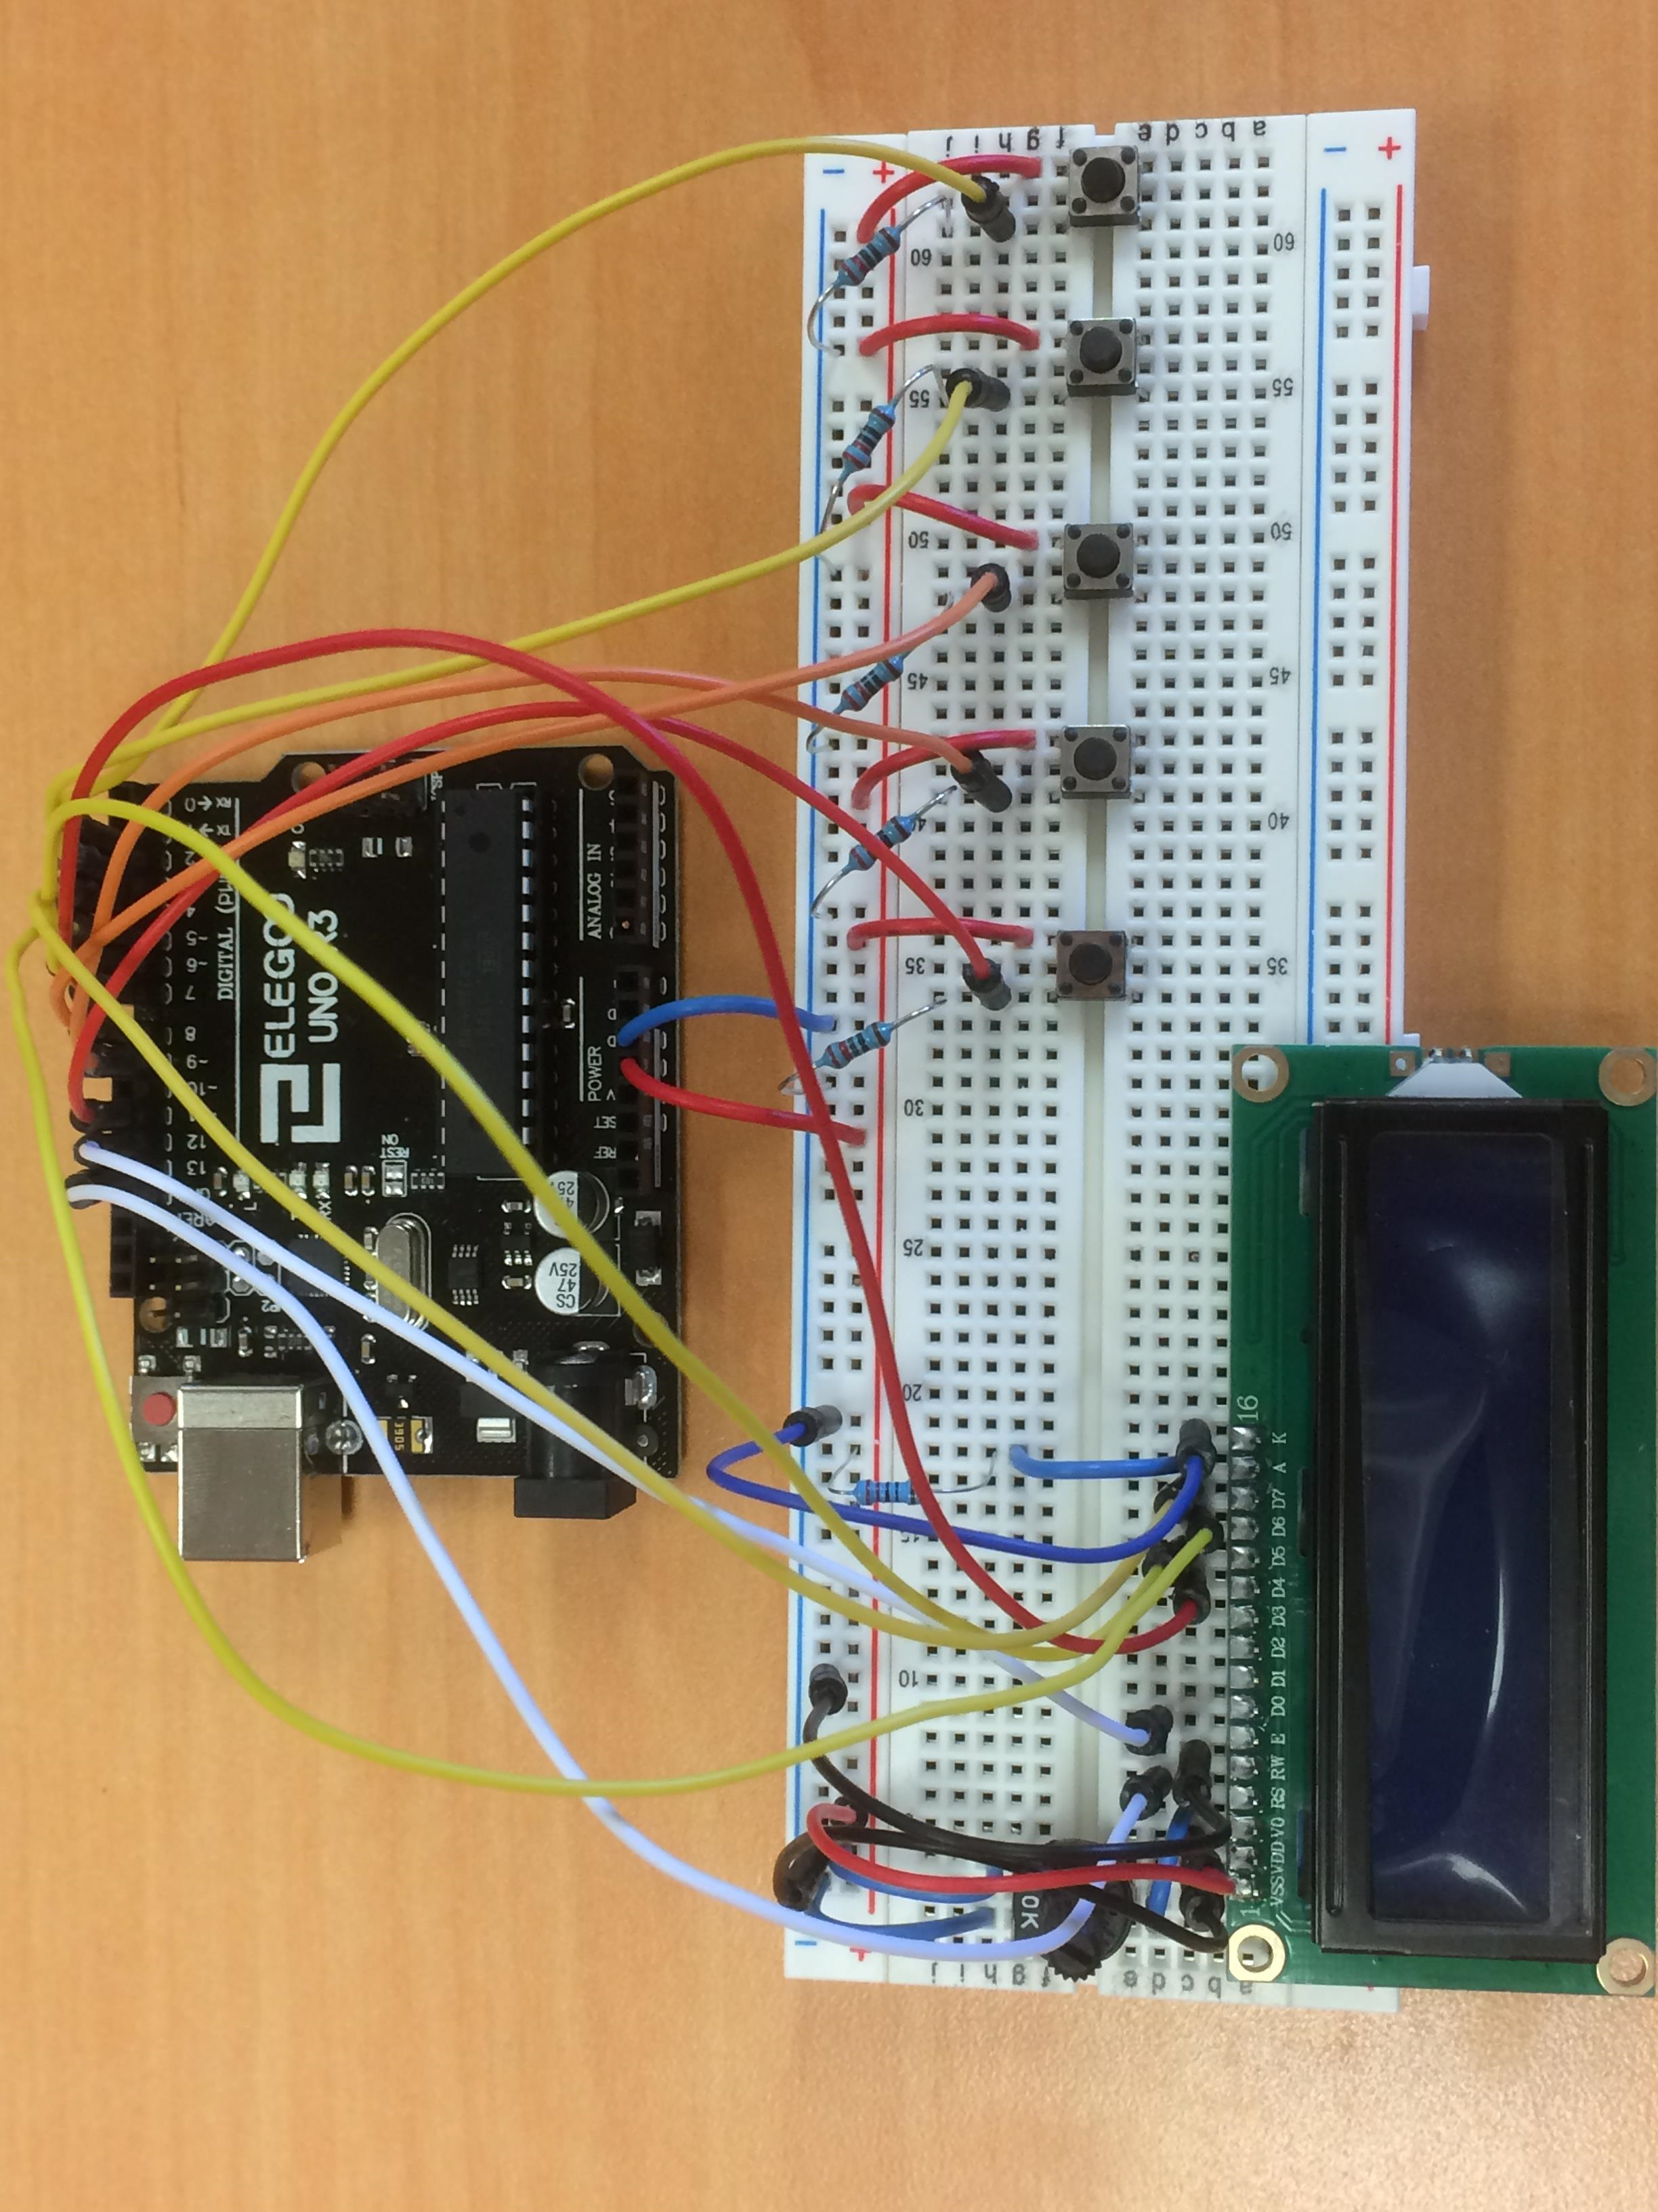
Abstract
The LCD screen will display a random number between 1 and 99, followed by the word “cents”. The user will have to reach that number by adding quarters, dimes, nickels and pennies together.

Slide 5
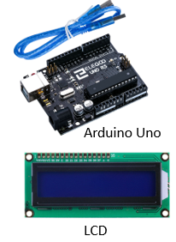
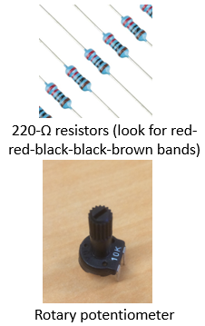
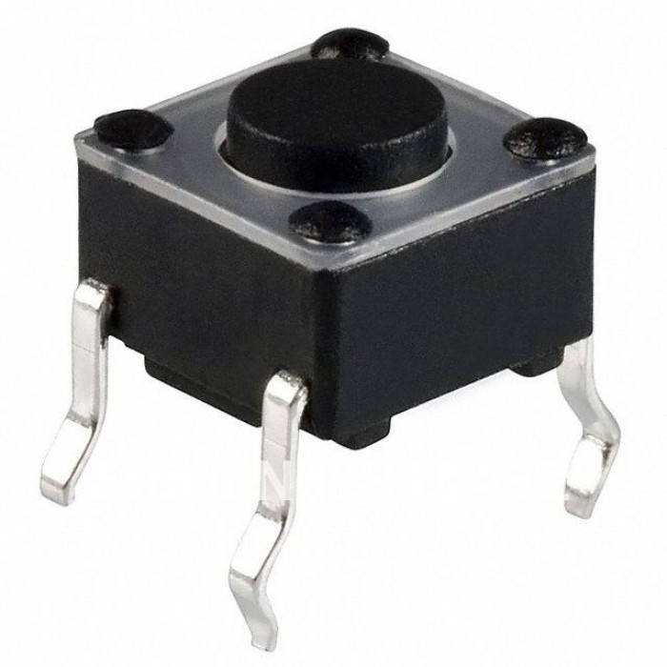
Materials
Arduino Uno
16 x 2 LCD
Rotary potentiometer
Five pushbuttons
Six 220-Ω resistors
Many jumper wires
Pushbutton

Slide 6
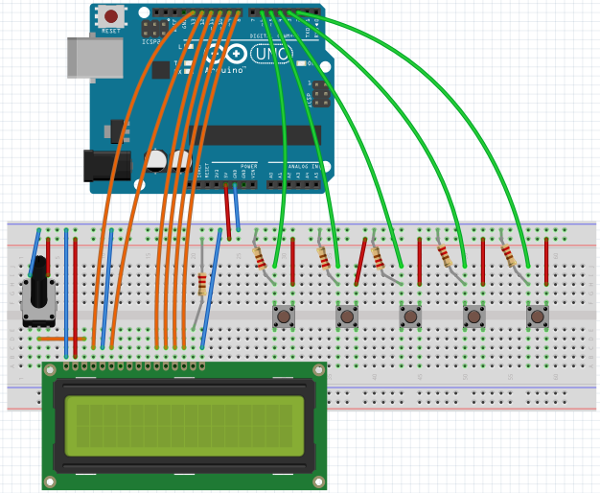
The Circuit
The LCD is connected to ports 13, 12, 11, 10, 9 and 8.
The buttons are connected to ports 6, 5, 4, 3 and 2.

Slide 7
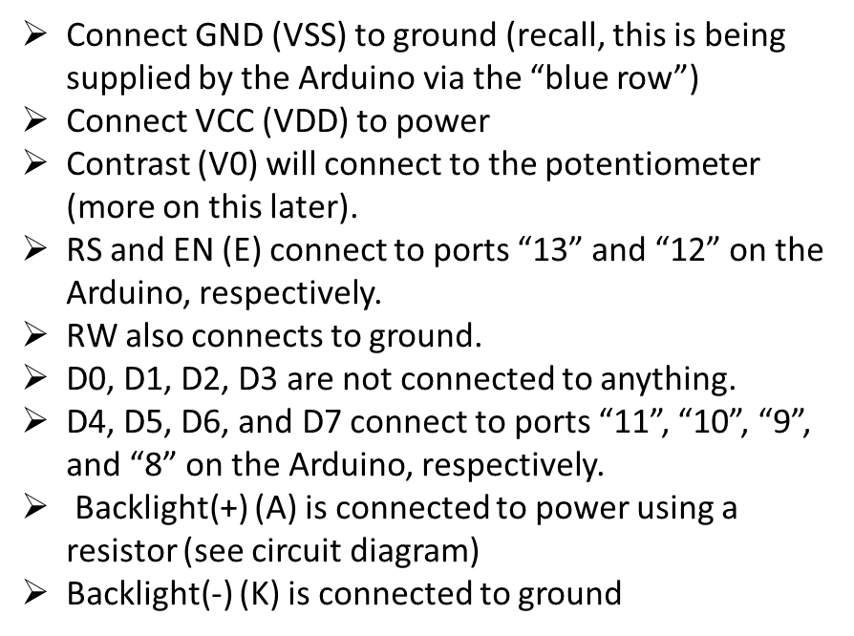
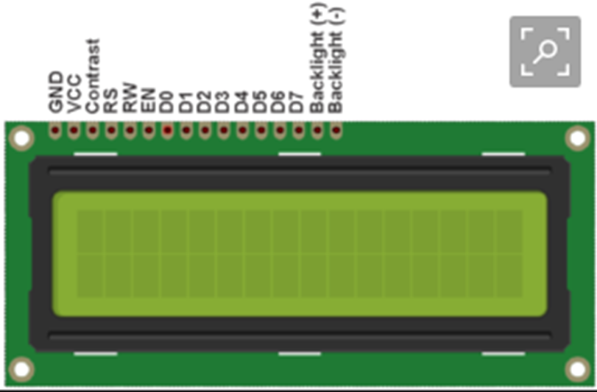
Building the Circuit
The LCD is the most complex piece of the circuit, since it’s connected to a lot of wires. Refer to this diagram if there is confusion about what goes where.

Slide 8

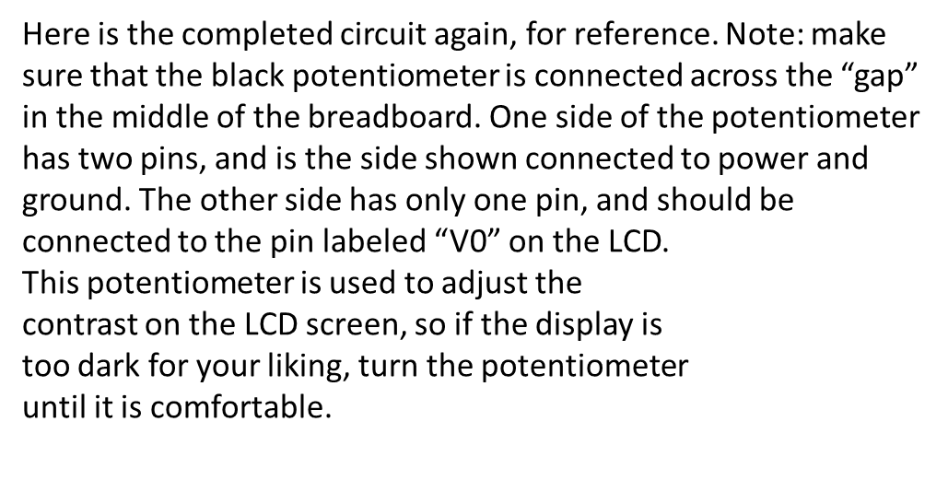
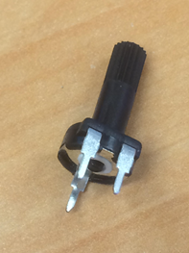
Building the Circuit
Also, make sure that each of the pushbuttons is connected to the correct numbered port. From left to right: button 1 -> 6, button 2 -> 5, button 3 -> 4, button 4 -> 3, and button 5 -> 2.

Slide 9
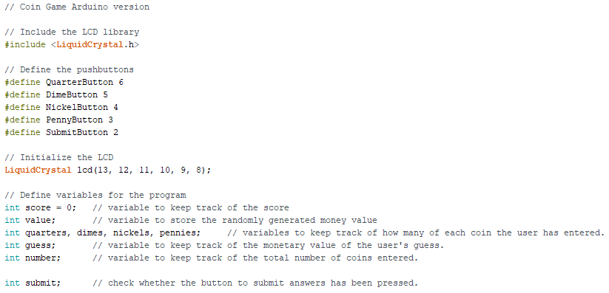
The Code
A few blocks of code are missing in the skeleton code. Refer to the next few slides to complete the code.

Slide 10
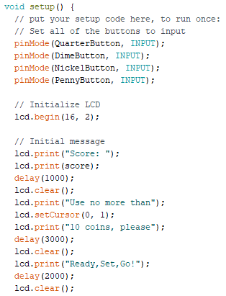
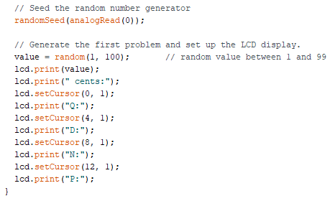
The Code
Continued

Slide 11
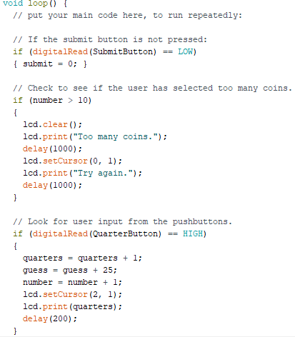
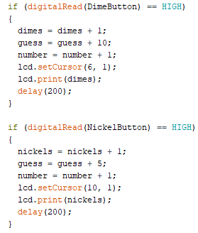
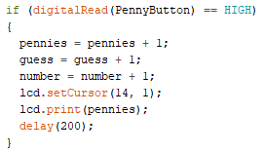
The Code
Continued

Slide 12
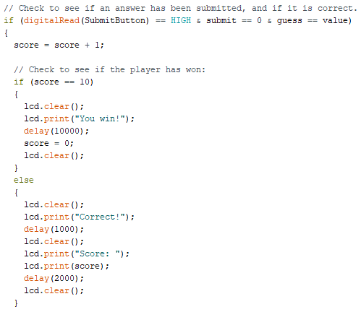
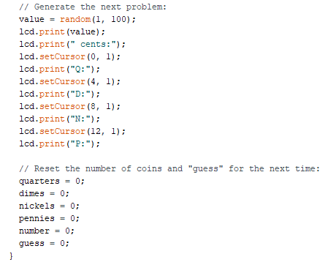
The Code
Continued

Slide 13
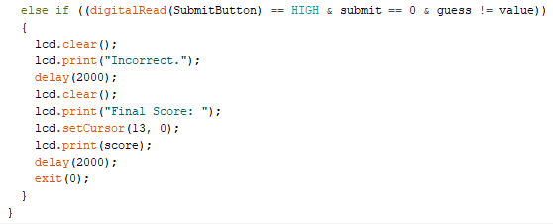
The Code
What happens if the user presses submit on an answer that is not correct? The text will display, but only if the guess is not correct.
This is implemented using an else if statement, which executes only if the previous if condition was false AND the else if condition is true.

Slide 14
You’re Ready to Start Playing!
Always double-check your wiring before plugging in the board and running the code.
Make sure that the Board and COM port are correct. Do this by finding the “Tools” tab in the Arduino toolbar, and then make sure:
Board: “Arduino/Genuino Uno”
Port: “COM# (Arduino/Genuino Uno)”

Slide 15
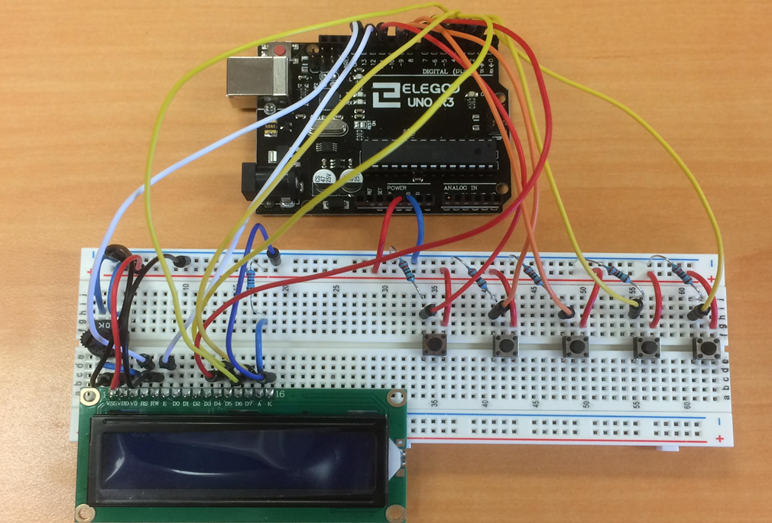
Playing the Game
When the Arduino is plugged in, the LCD should display “Score: 0”, followed by “Use no more than 10 coins, please”, followed by “Ready, Set, Go!”
Two seconds later, the first problem will display on the top line, a random cent value between 1 and 99.
The circuit has five buttons. Four of them represent coins, and the last one is used to submit the answer: from left to right: Quarter, Dime, Nickel, Penny and Submit.

Slide 16
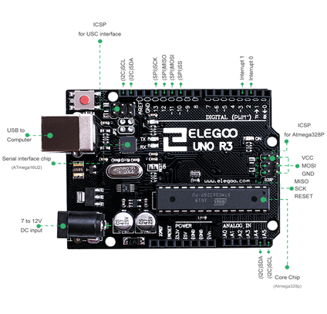
Playing the Game, cont.
Add coins until the combined value of all of the inputted coins equals the amount displayed on the LCD screen. When satisfied, press the Submit button. Get to 10 correct answers to win!
Note that the game prevents you from using more than 10 coins, to prevent something like 37 cents from being reached by pressing penny 37 times.
It may be helpful to provide physical coins to the kids to go along with the game, so that they can use a visual aid to help count.
To re-start the game if the answer is incorrect or if more than 10 coins are used, press the red button above the USB plug-in. Enjoy!

